Slide 1




Heart Disease Prediction Using Logistic Regression

Slide 2




Our Team
Sahil Anwar RA2011042010131
Uday Kumar RA2011042010128

Slide 3






Table of Contents
01
Introduction
02
Abstract
03
Problem Statement
04
Motivation
05
Innovation Idea of Project
06
Scope of Project

Slide 4

Introduction
It is difﬁcult to identify heart disease because of several contributory risk factors such as diabetes, high blood pressure, high cholesterol, abnormal pulse rate and many other factors.
Among various life threatening diseases, heart disease has garnered a great deal of attention in medical research .
The diagnosis of heart disease is a challenging task , which can offer automated prediction about the heart condition of patient so that further treatment can be made effective.
The diagnosis of heart disease is usually based on signs, symptoms of the patient .
The nature of heart disease is complex and hence, the disease must be handled carefully. Not doing so may affect the heart or cause premature death.

Slide 5
Abstract
The diagnosis of heart disease in most cases depends on a complex combination of clinical and pathological data. Because of this complexity, there exists a significant amount of interest among clinical professionals and researchers regarding the efficient and accurate prediction of heart disease. In this paper, we develop a heart disease predict system that can assist medical professionals in predicting heart disease status based on the clinical data of patients. Our approaches include three steps. Firstly, we select 13 important clinical features, i.e., age, sex, chest pain type, trestbps, cholesterol, fasting blood sugar, resting ecg, max heart rate, exercise induced angina, old peak, slope, number of vessels colored, and thal. Secondly, we develop an logistic regression model for classifying heart disease based on these clinical features. Finally, we develop a user-friendly heart disease predict system (HDPS). The HDPS system will be consisted of multiple features, including input clinical data section and prediction performance display section (execute time, accuracy, sensitivity, specificity, and predict result). Our approaches are effective in predicting the heart disease of a patient.

Slide 6
Problem Statement
Heart disease prediction using machine learning algorithm (Logistic Regression Model)

Slide 7
Motivation
A major challenge facing healthcare organizations is the provision of quality services at affordable costs.
Quality service emplies diagnosing patients correctly and administering treatments that are effective .
Poor clinical decisions can lead to disastrous consequences which are therefore unacceptable
.
Hospitals must also minimize the cost of clinical tests .
They can achieve this results by employing appropriate computer based information and decision support system.

Slide 8



Innovation Idea of Project
The main objective of this research is to develop a heart
prediction system, the system can discover and extract hidden knowledge associated with diseases from heart data set.
Reduce the cost of medical tests.
01
02
03
04
This system aims to exploit machine learning techniques on medical data set to assist in the prediction of the heart disease.
To help avoid human biases.

Slide 9

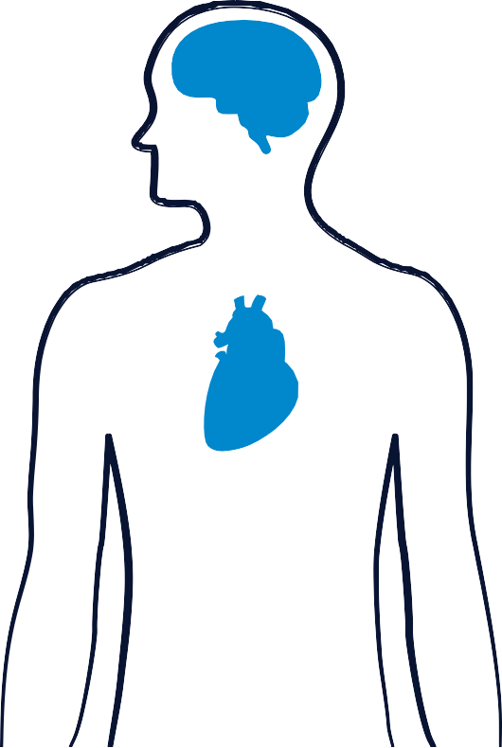



Scope of the Project
A
Medical Institutions:- To teach medical students how the heart attack been measured, or how to identify that the person is suffering from heart disease.
B
Hospitals:- To detect that is the person having heart disease or not.

Slide 10
DataSet Link
DATASET FOR HEART DISEASE

Slide 11




Thank You
CREDITS: This presentation template was created by Slidesgo, including icons by Flaticon and infographics & images by Freepik

